Slide 1
SAP HANA SQL Introduction

Slide 2
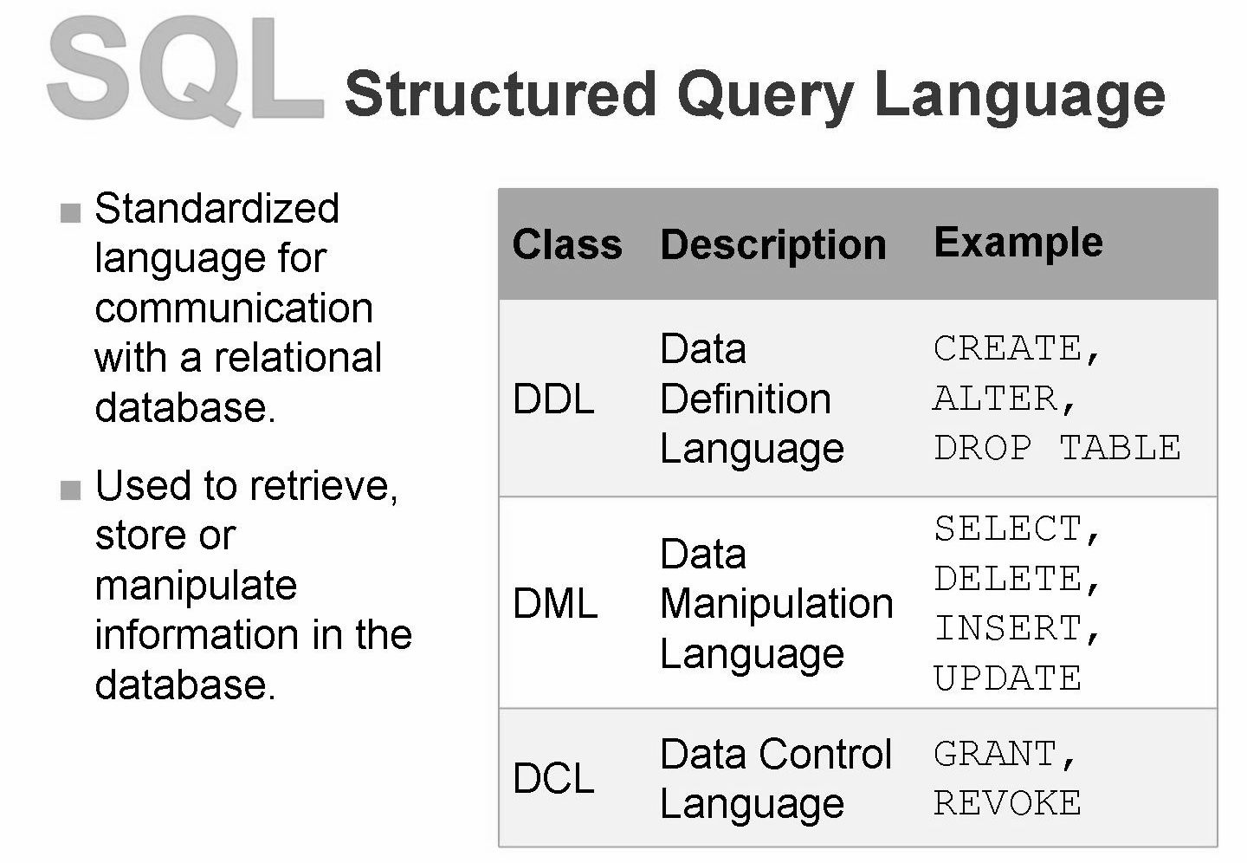

Slide 3
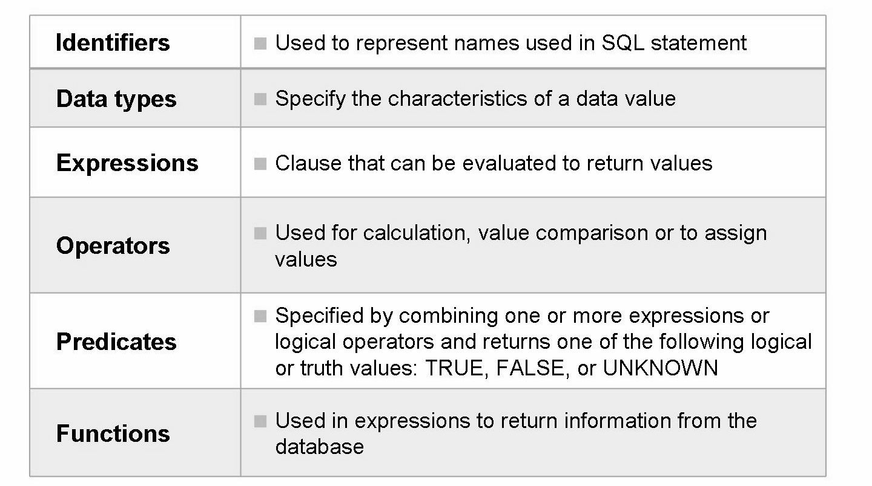
SQL language elements
SELECT MANDT, KUNNR, TRIM(NAME1) || TRIM(NAME2) AS FULL_NAME FROM KNA1 WHERE LAND1 = ‘IN’

Slide 4
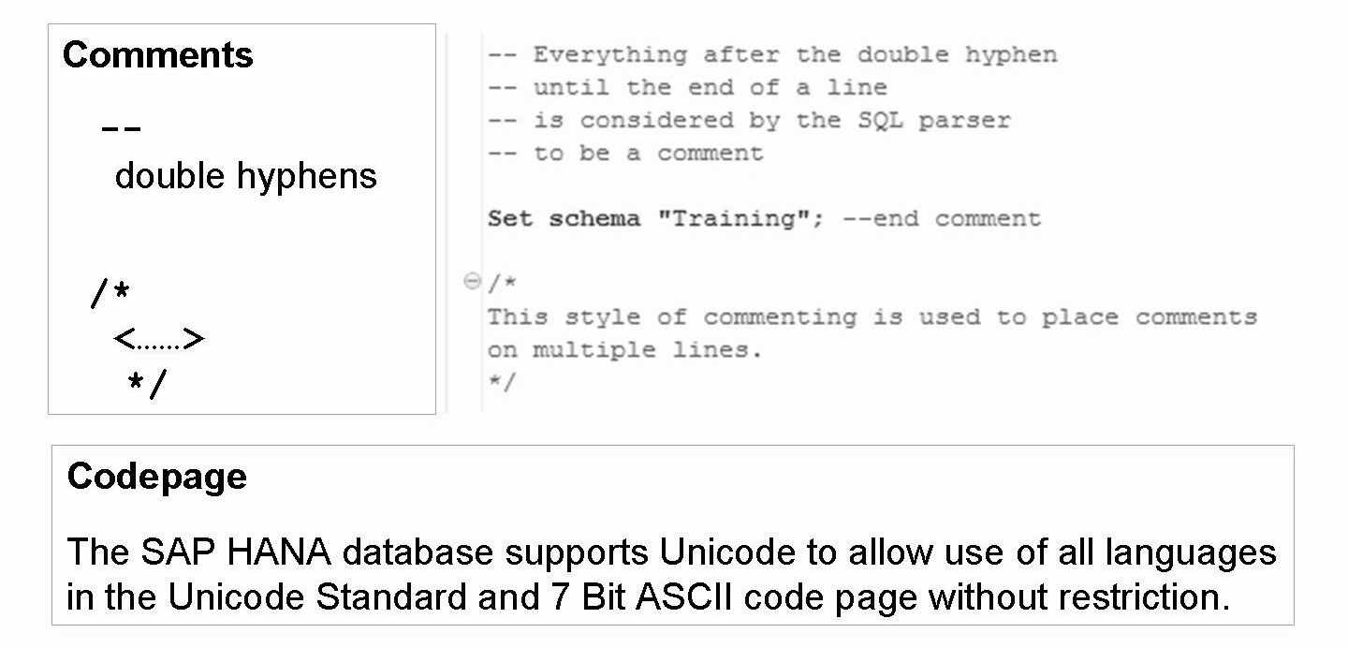
Comment and Code page

Slide 5
Identifiers
Identifiers are used to represent names used in SQL statement including:
table name
view name
synonym name
column name
index name
function name
procedure name
user name
role name, and so on

Slide 6
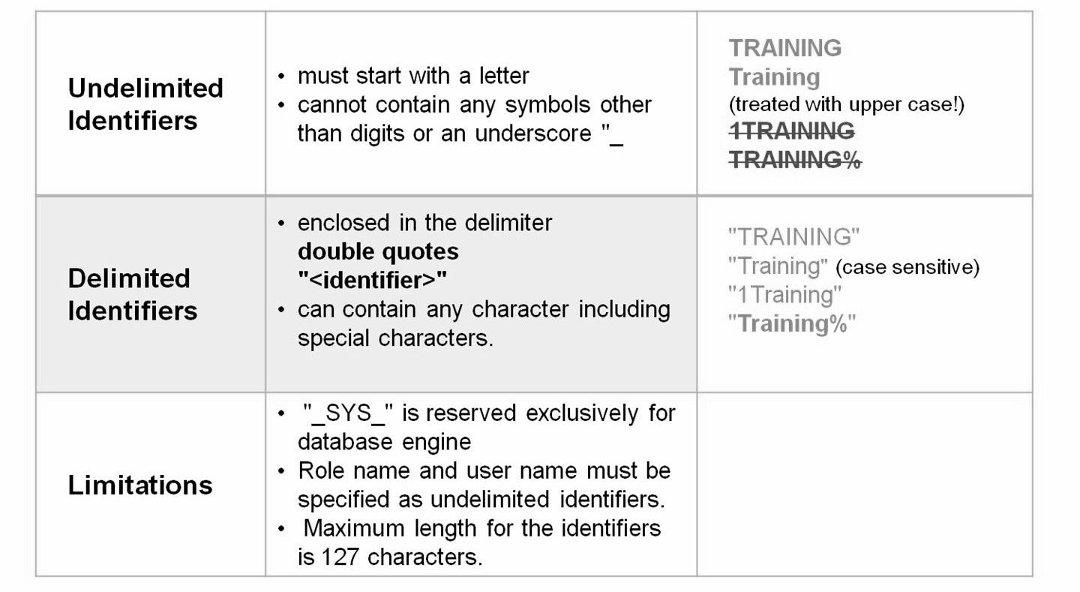
Identifiers

Slide 7
Identifiers are used to represent names used in SQL statement including
table name, view name, synonym name, column name, index name, function name, procedure name, user name, role name, and so on
“→AB$%CD→” is a valid identifier name in delimited identifiers
Single Quotation Mark
Single quotation marks are used to delimit string literals and a single quotation mark itself can be represented using two single quotation marks such as in the given example.
Double Quotation Mark
Double quotation marks are used to delimit identifiers and double quotation mark itself can be represented using two double quotation marks.
Example
select 'String', 'SAP''s current offering' from "DUMMY”

Slide 8
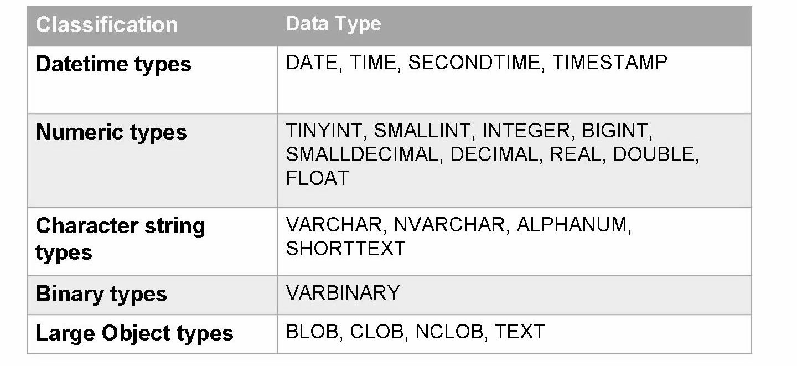
SQL Data types
Note: A special value of NULL is included in every data type to indicate the absence of a value.

Slide 9
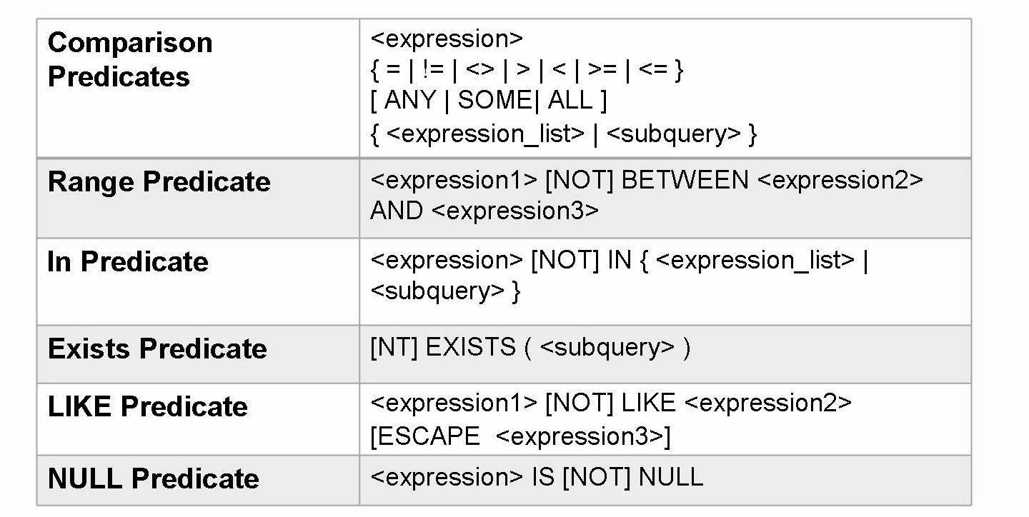
Predicates
LIKE Predicate
• The percentage sign (%) matches zero or more characters and underscore (_)matches exactly one character. To match a percent sign or underscore in the LIKE predicate, an escape character must be used.
• Using the optional argument, ESCAPE expression3, you can specify the escape character that will be used so that the underscore (_) or percentage sign (%) can be matched.

Slide 10
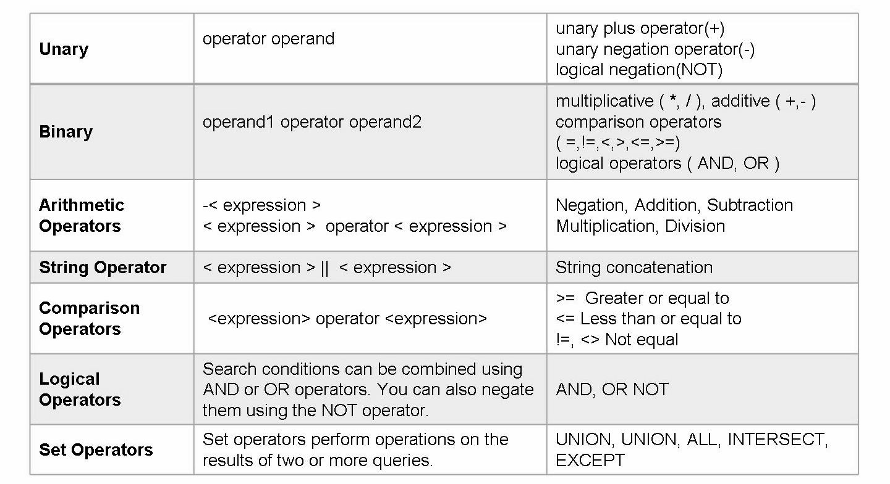
Operators
You can perform operations in expressions by using operators. Operators can be used for calculation, value comparison or to assign values.

Slide 11
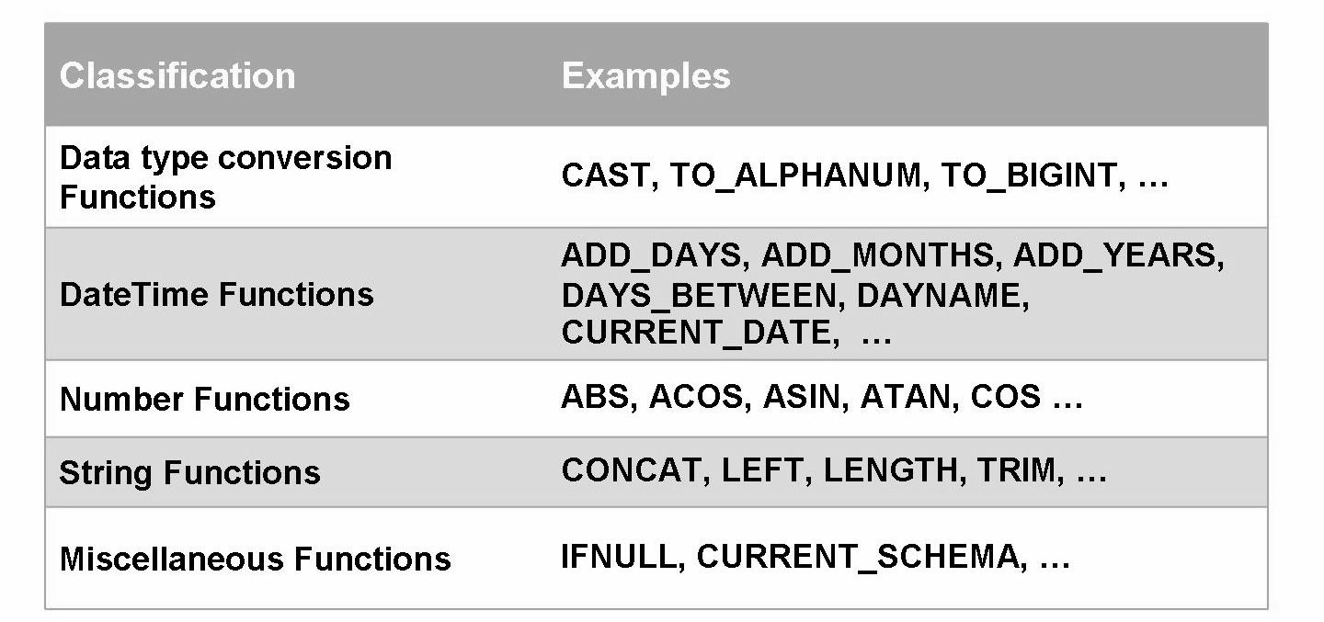
Functions
Functions provide a reusable method to evaluate expressions and return information from the database. They are allowed anywhere an expression is allowed. Functions use the same syntax conventions used by SQL statements.

Slide 12
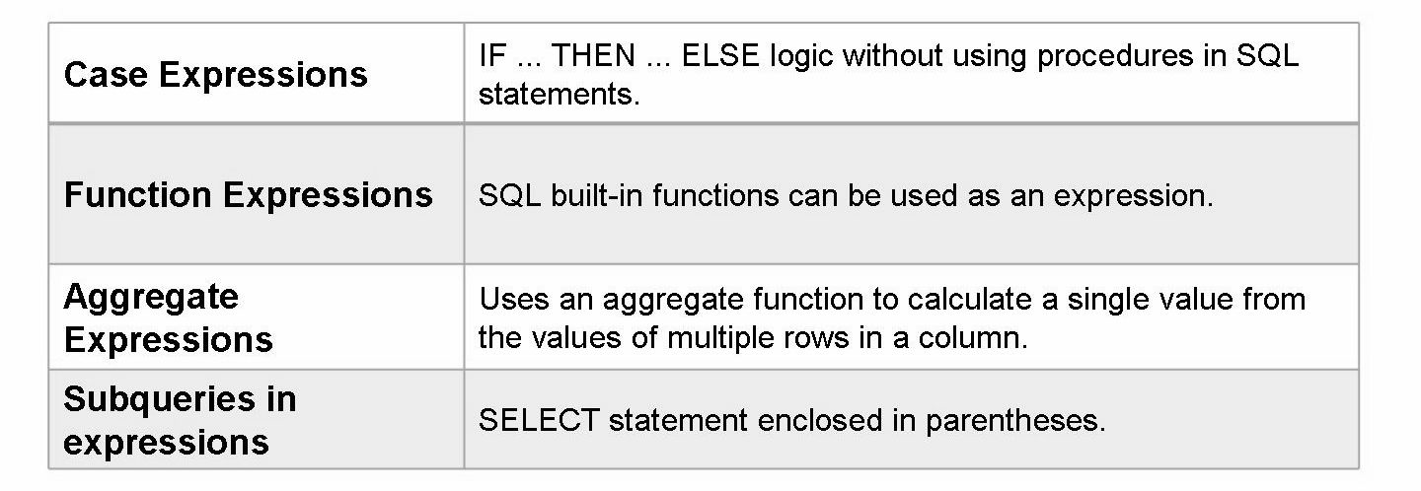
Expressions
An expression is a clause that can be evaluated to return values.

Slide 13
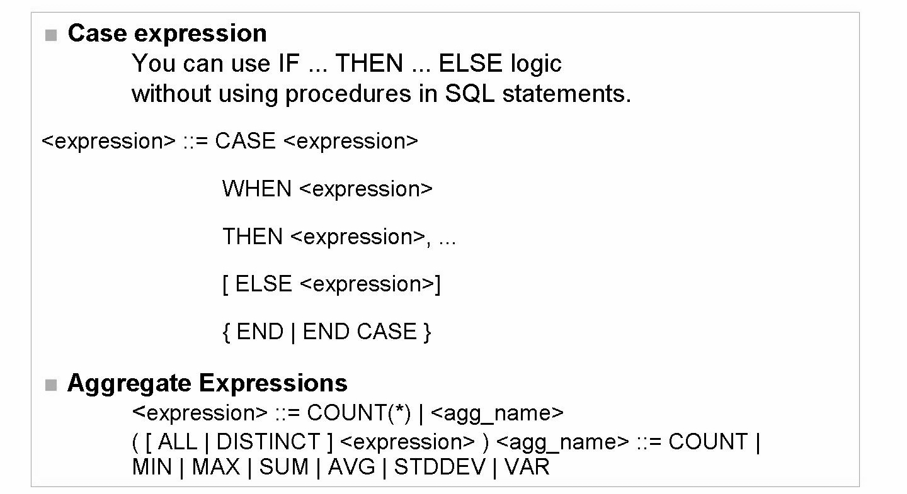

Slide 14
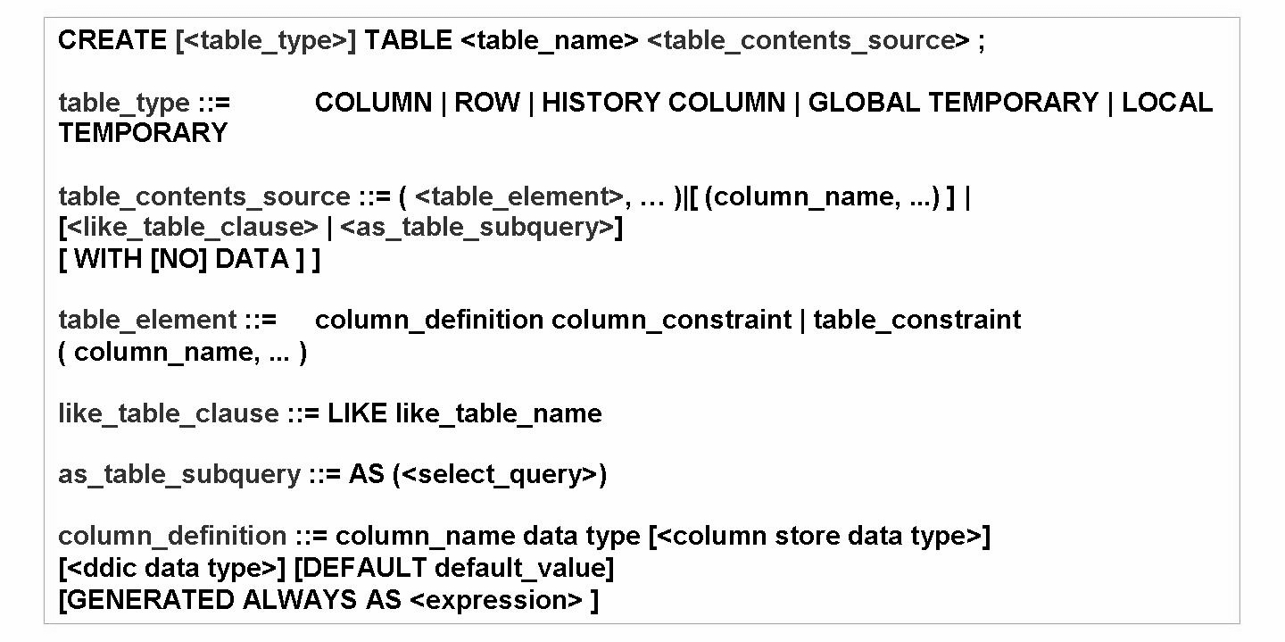
SQL statement: Create Table

Slide 15
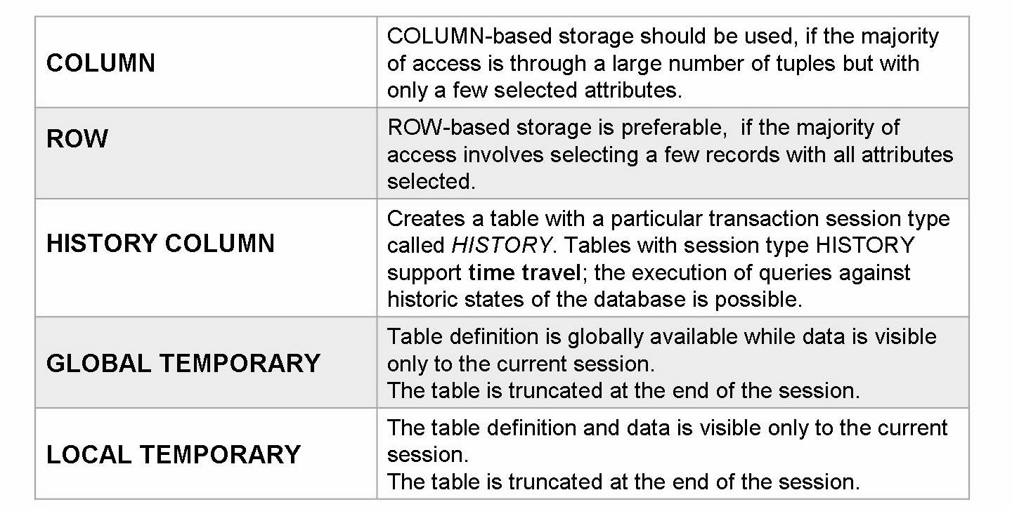
Create Table - Table Types

Slide 16
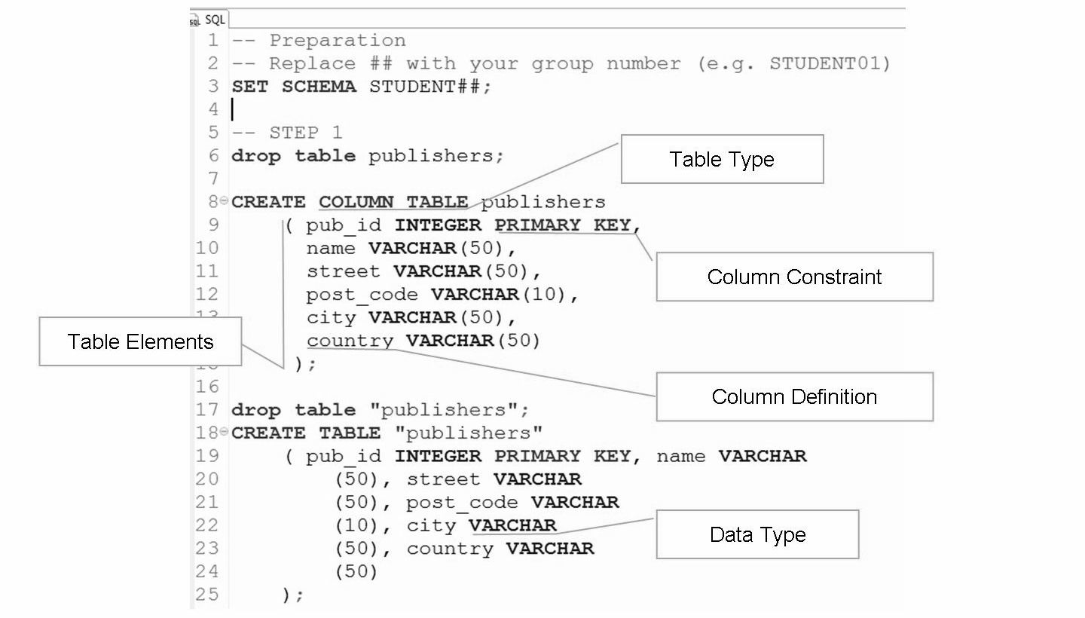
column_constraint ::= NULL | NOT NULL | UNIQUE [BTREE | CPBTREE] |PRIMARY KEY [BTREE | CPBTREE]

Slide 17
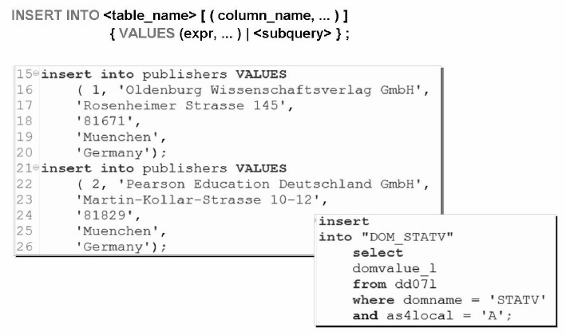
SQL statement: Insert

Slide 18
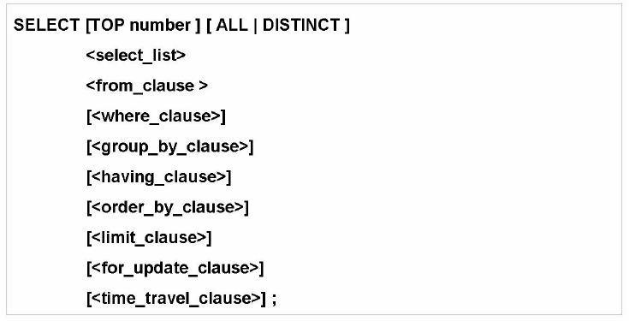
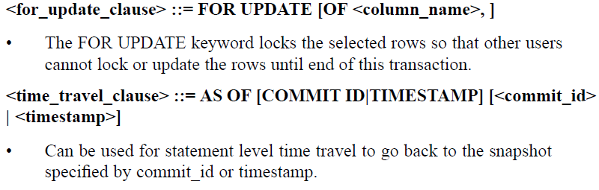

Slide 19
THANK YOU
Courtesy : SAP Labs Document -
HA 300 – SAP HANA Implementation and Modeling

